Slide 1
The "Book Library" App
Design and implement a “Book Library” with Cordova, jQuery Mobile and REST back-end in Kinvey
Books have title, author and description
Implement the following functionality:
Login, register, logout, list all books, create a new book, edit existing book, delete existing book
Books have ownership:
Anyone can view all the books
Only the book creator can edit / delete his own books

Slide 2
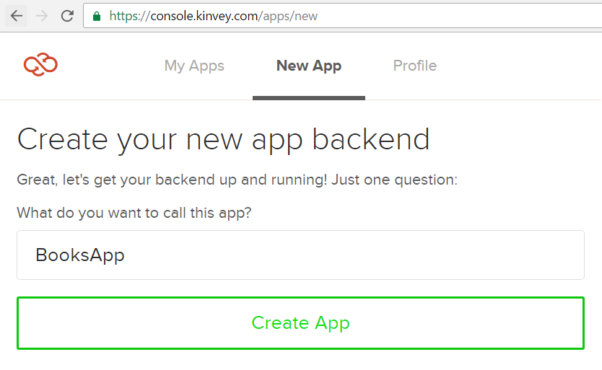
Create Kinvey App

Slide 3
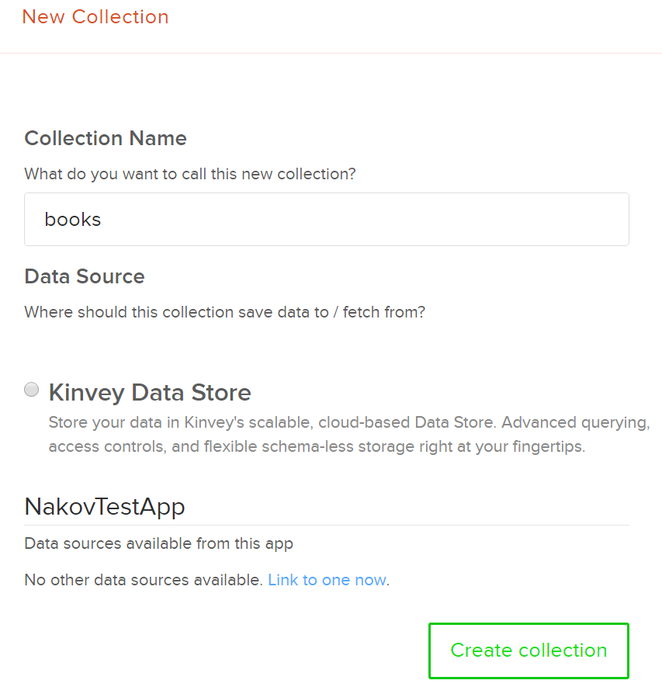
Create Books Collection

Slide 4
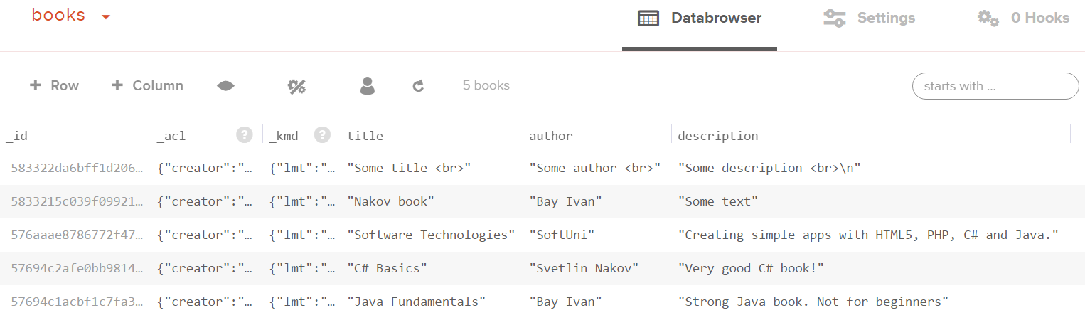
Add a few books
Columns: title + author + description

Slide 5
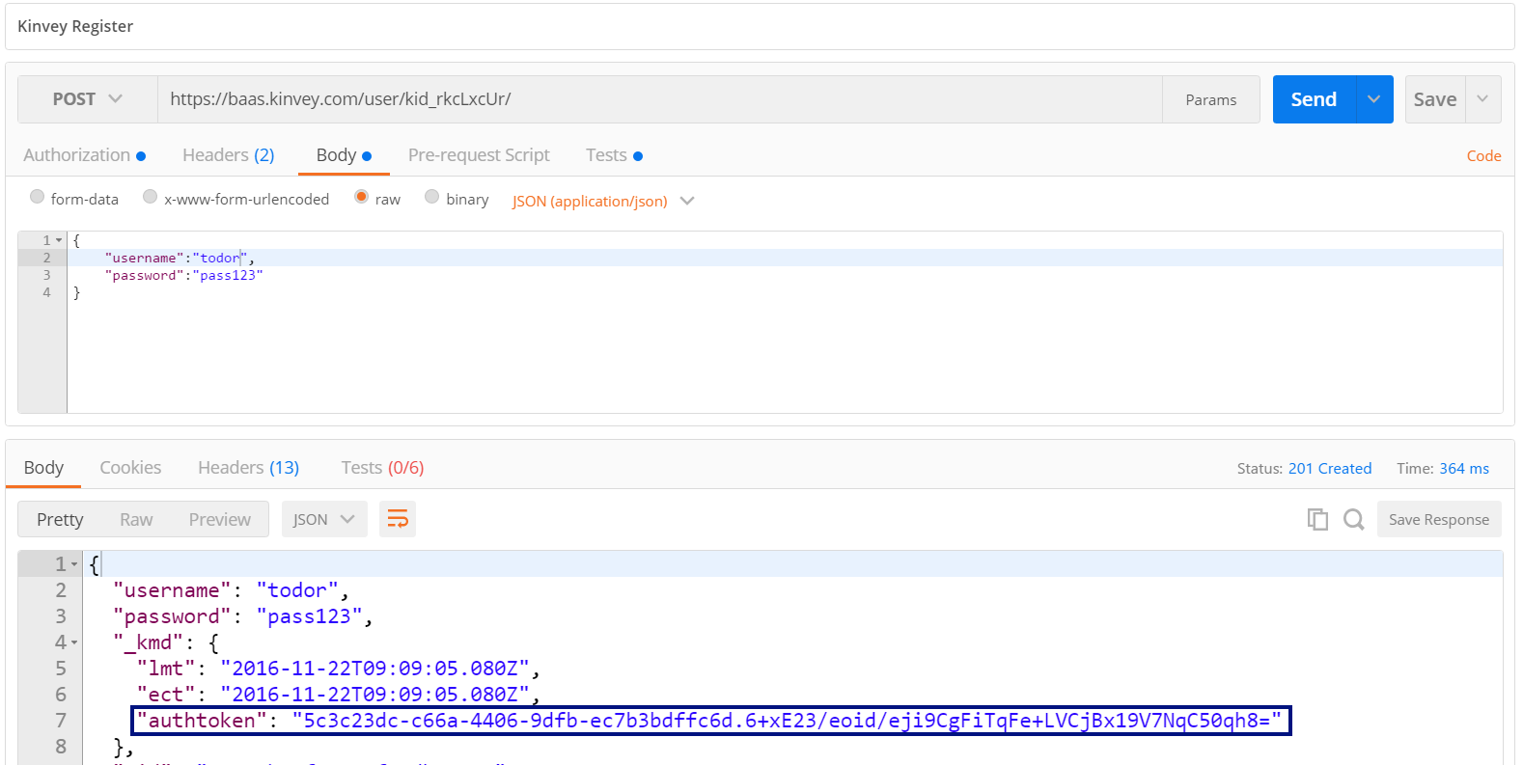
Test the Kinvey Back-End: Register User
POST
https://baas.kinvey.com/user/{app_id}/
Authorization: Basic base64(app_id:app_secret)
{"username":"todor", "password":"pass123"}

Slide 6
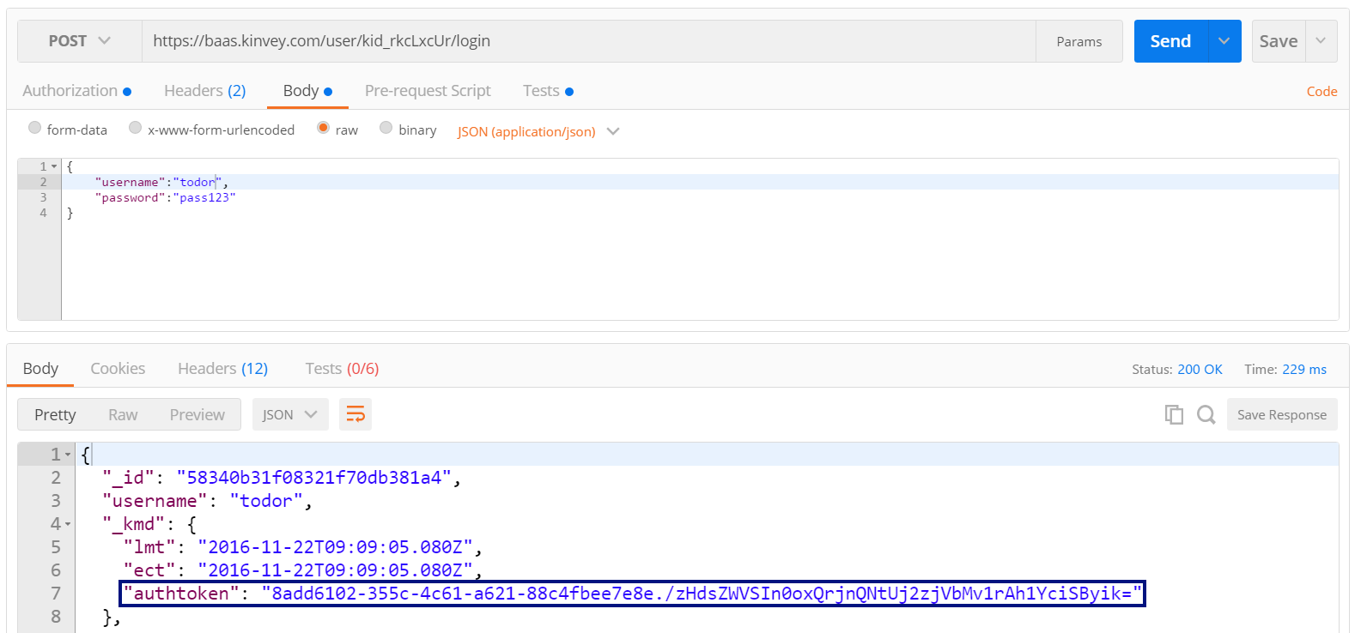
Test the Kinvey Back-End: Login User
POST
https://baas.kinvey.com/user/{app_id}/login
Authorization: Basic base64(app_id:app_secret)
{"username":"todor", "password":"pass123"}

Slide 7
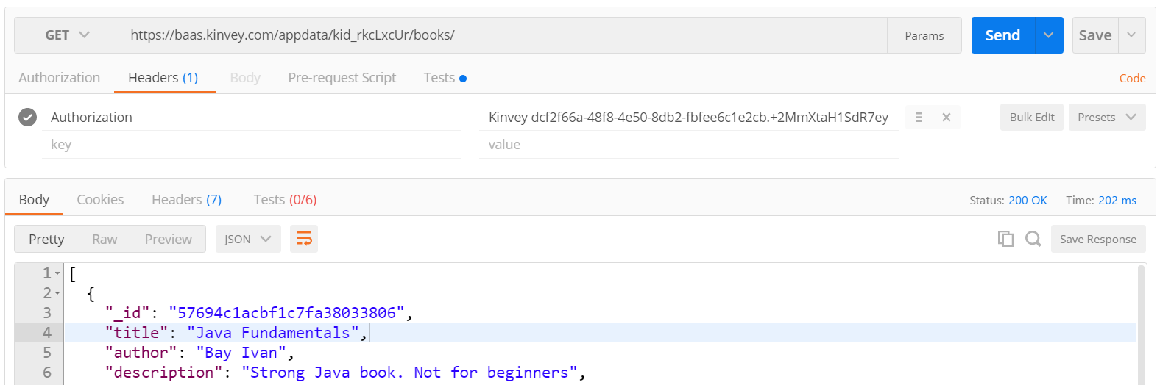
Test the Kinvey Back-End: List All Books
GET
https://baas.kinvey.com/appdata/{app_id}/books
Authorization: Kinvey authtoken

Slide 8
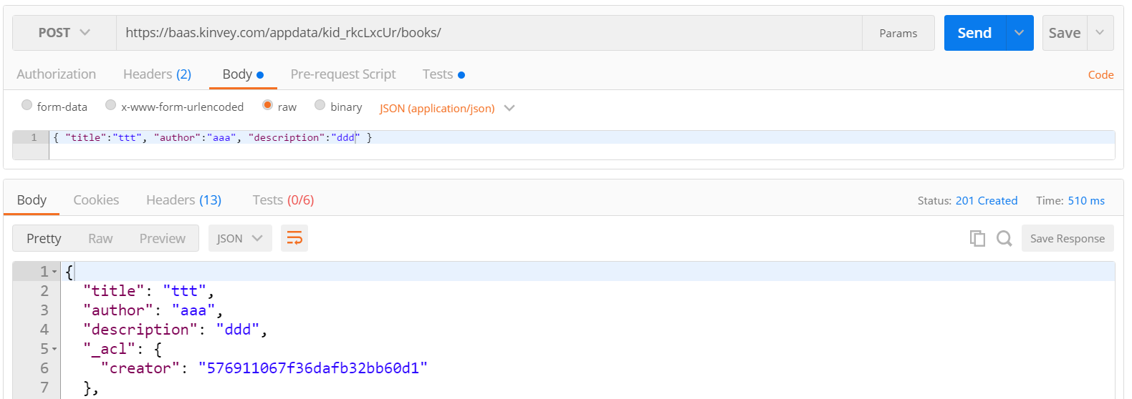
Test the Kinvey Back-End: Create New Book
POST
https://baas.kinvey.com/appdata/{app_id}/books
Authorization: Kinvey authtoken
{ "title":"ttt", "author":"aaa", "description":"ddd" }

Slide 9
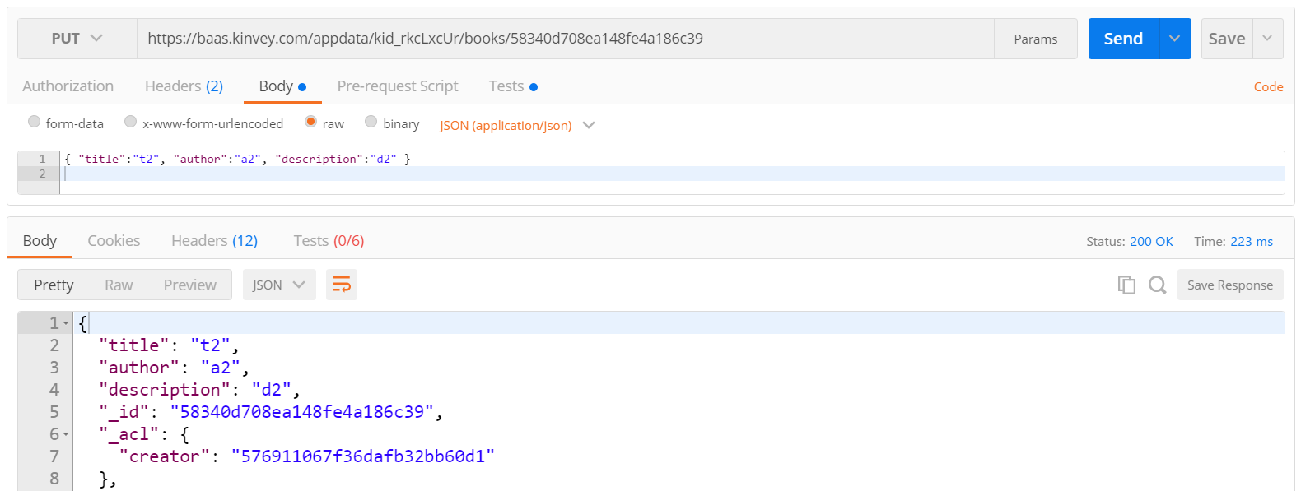
Test the Kinvey Back-End: Edit Book
PUT
https://baas.kinvey.com/appdata/{app_id}/books/{id}
Authorization: Kinvey authtoken
{ "title":"t2", "author":"a2", "description":"d2" }

Slide 10
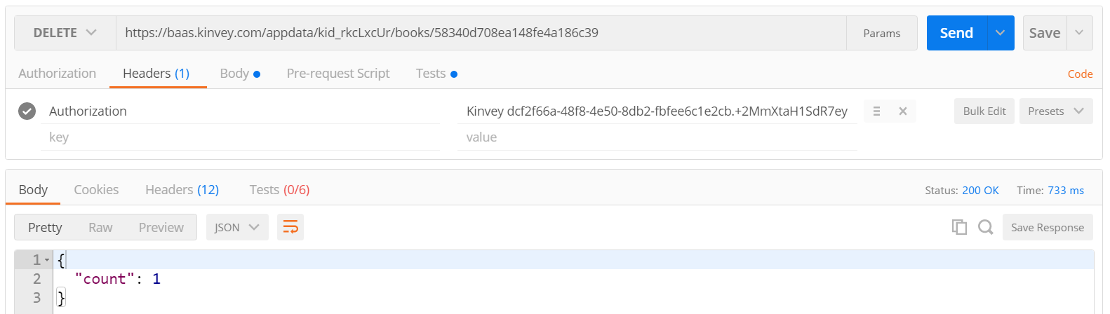
Test the Kinvey Back-End: Delete Book
DELETE
https://baas.kinvey.com/appdata/{app_id}/books/{id}
Authorization: Kinvey authtoken

Slide 11
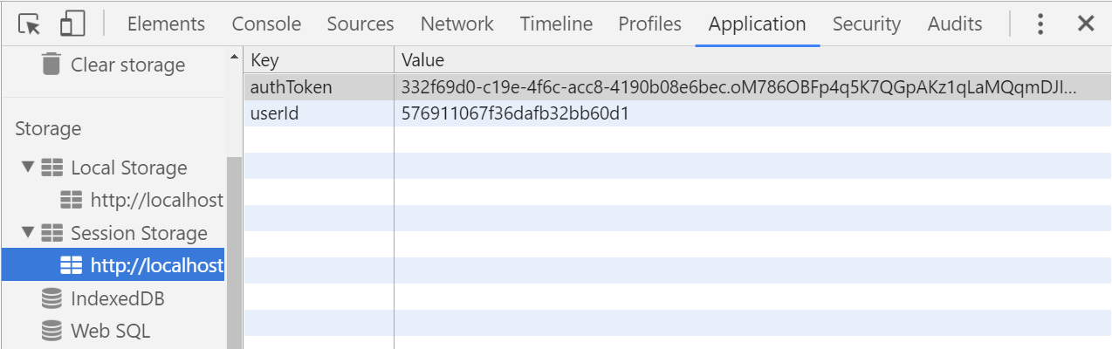




Session / Local Storage

Slide 12
Session / Local Storage – Overview
Session storage holds key / value pairs in the browser session
All data is lost when the browser is closed, survives page reloads
// Save data to sessionStorage
sessionStorage.setItem('username', 'maria');
// Get saved data from sessionStorage
let currentUser = sessionStorage.getItem('username');
// Remove all saved data from sessionStorage
sessionStorage.clear();

Slide 13
User Registration: AJAX Request
function registerUser() {
let userData = {
username: $('#formRegister input[name=username]').val(),
password: $('#formRegister input[name=passwd]').val()
};
$.ajax({
method: "POST",
url: kinveyBaseUrl + "user/" + kinveyAppKey + "/",
headers: kinveyAppAuthHeaders,
data: userData,
success: registerSuccess,
error: handleAjaxError
});

Slide 14
Remember User Authentication Data
function saveAuthInSession(userInfo) {
let userAuth = userInfo._kmd.authtoken;
sessionStorage.setItem('authToken', userAuth);
let userId = userInfo._id;
sessionStorage.setItem('userId', userId);
let username = userInfo.username;
$('#loggedInUser').text(
"Welcome, " + username + "!");
}

Slide 15
Handle AJAX Errors: Show the Error Box
function handleAjaxError(response) {
let errorMsg = JSON.stringify(response);
if (response.readyState === 0)
errorMsg = "Cannot connect due to network error.";
if (response.responseJSON &&
response.responseJSON.description)
errorMsg = response.responseJSON.description;
showError(errorMsg);
}

Slide 16
User Login: AJAX Request
function loginUser() {
let userData = {
username: $('#formLogin input[name=username]').val(),
password: $('#formLogin input[name=passwd]').val()
};
$.ajax({
method: "POST",
url: kinveyBaseUrl + "user/" + kinveyAppKey + "/login",
headers: kinveyAppAuthHeaders,
data: userData,
success: loginSuccess,
error: handleAjaxError
});

